Slide 1

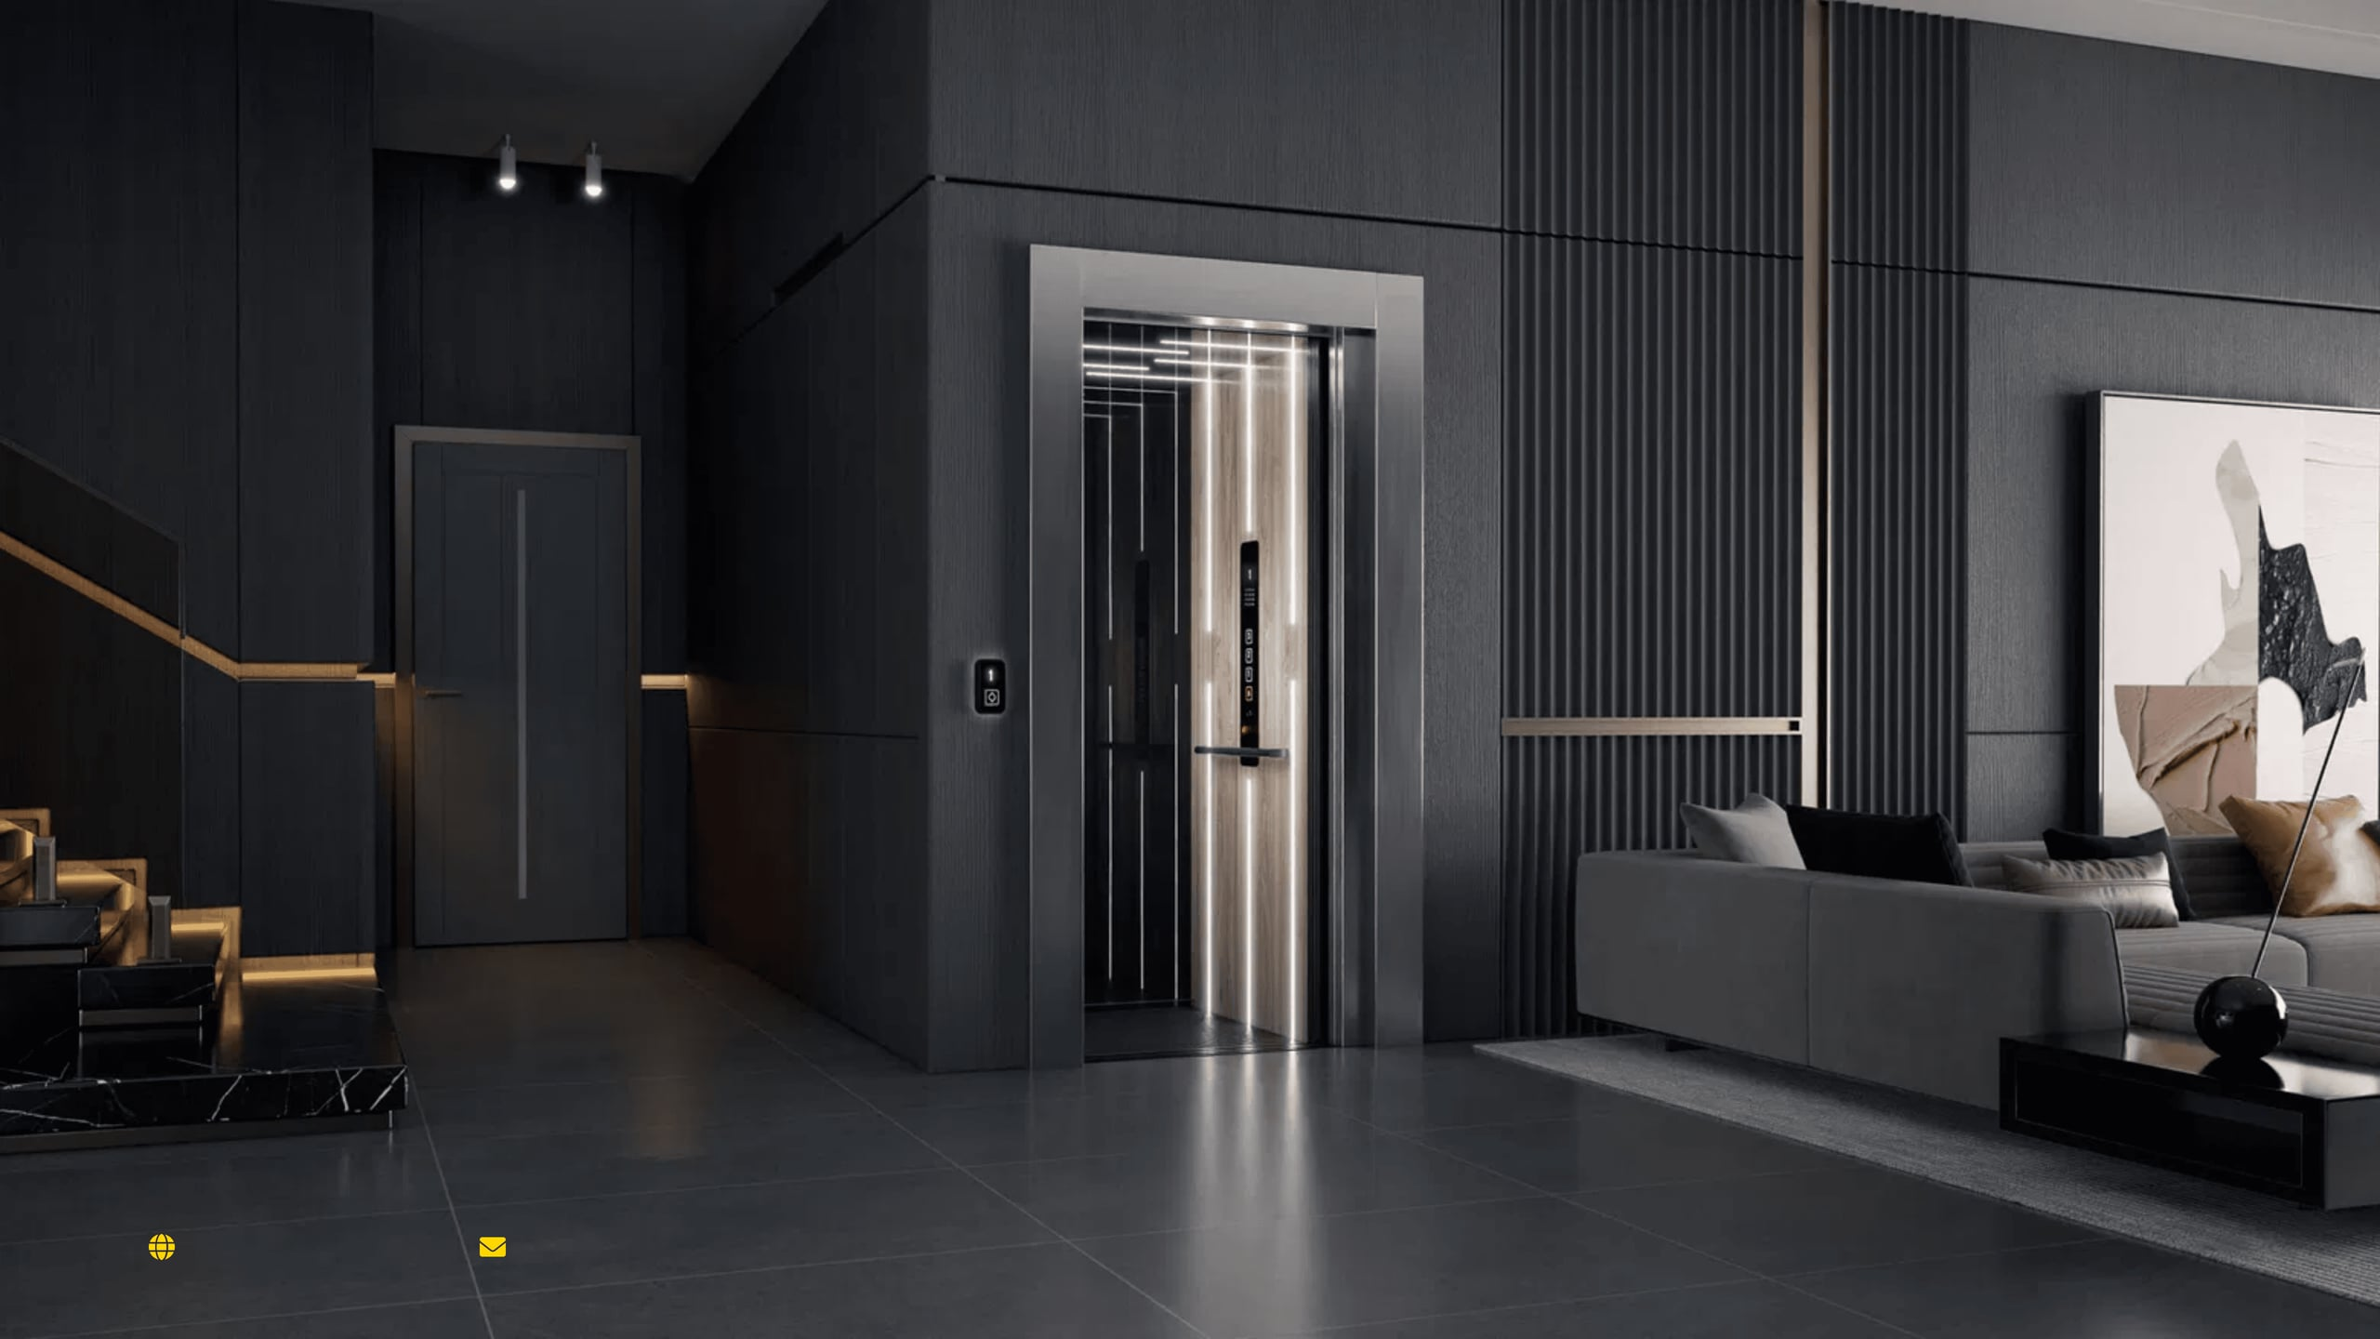

Elevating
West Africa’s
Urban Future
Premium Pneumatic Elevator Solutions for Public Marketing, Investor Relations, and High-Level Client Meetings.
www.pelifts.com
info@pelifts.com

Slide 2




Redefining Vertical Mobility through Innovation and Accessibility
Our Mission
Our Vision
To provide West Africa with the most advanced, sustainable, and accessible elevator technology, enhancing lifestyle and productivity.
To become the undisputed leader in pneumatic elevator solutions across all 15 ECOWAS nations by 2030.
Innovation
Safety
Speed
Leveraging air-driven technology for zero-civil-work installations, eliminating construction mess and structural modifications.
Uncompromising European and American safety standards (ISO 9001, ASME) with fail-safe gravity descent systems.
Industry-leading 48-hour installation turnaround, ensuring minimal disruption to your residential or commercial space.

Slide 3

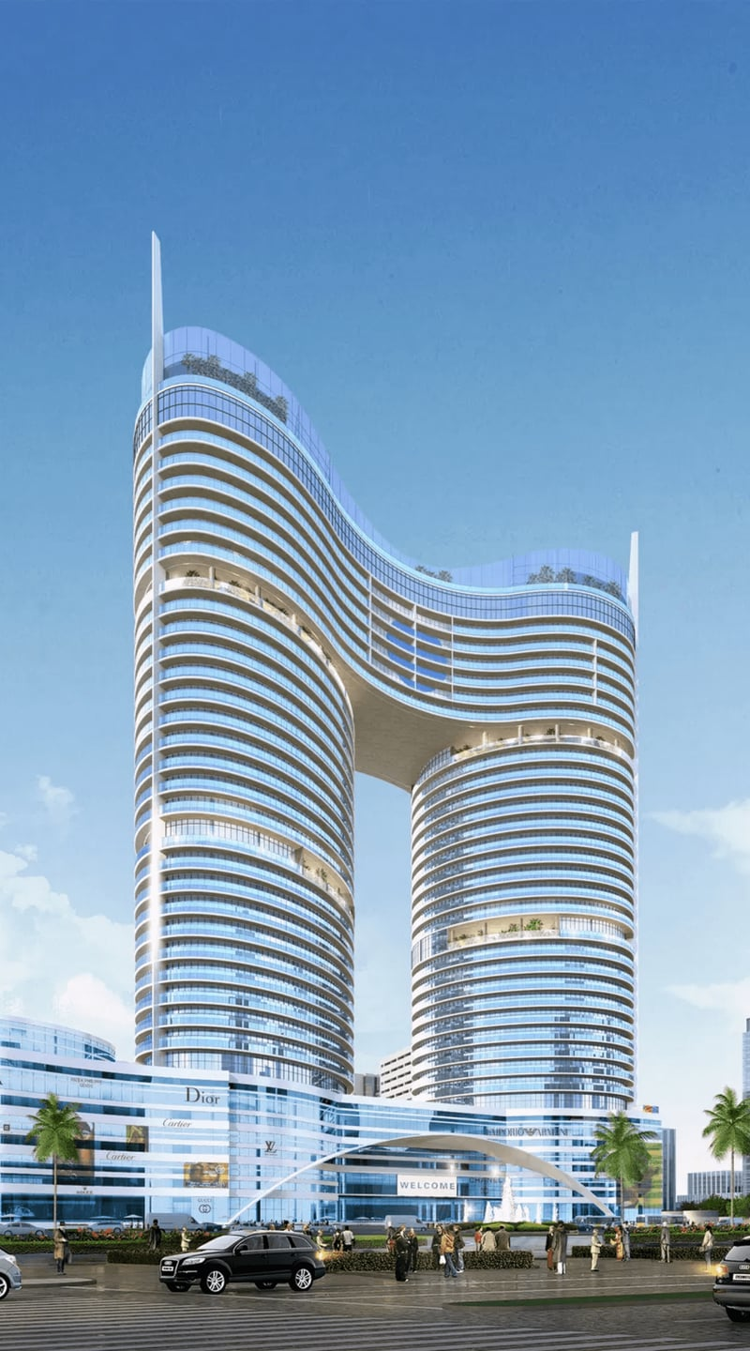
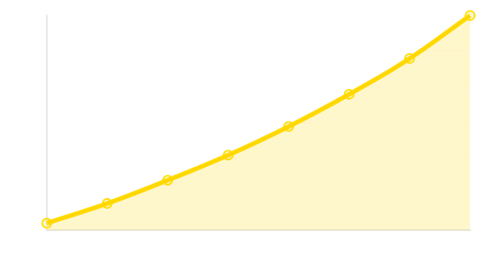
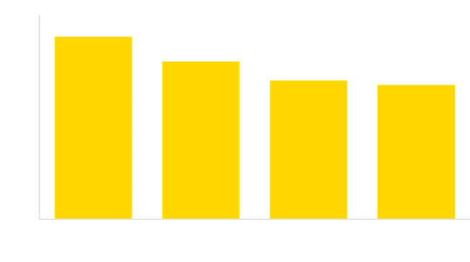

Capitalizing on the African Elevator Market Growth
Market Growth (USD Billions)
Regional Demand (CAGR %)
Application Segments
"Urbanization rates in West Africa are among the highest globally, driving a 10.2% CAGR in vertical transportation demand."
$2.2B
Market Value by 2030

Slide 4

Navigating the Rapid Urbanization of West African Megacities
160M+
Urban Growth Explosion
Africa has added over 160 million new urban inhabitants since 2015, with West African hubs like Lagos and Accra leading the continent's demographic shift.
44.7%
The Shift to Vertical Living
Urbanization rates have surged to 44.7%, making high-density residential and commercial towers the new standard for modern infrastructure in major ECOWAS cities.
70%
The Infrastructure Gap
Modern buildings require retrofit-friendly elevator solutions. Thousands of existing multi-story structures lack efficient vertical mobility, creating a massive modernization market.
"The Retrofit Opportunity: PE Lifts' zero-civil-work technology is uniquely positioned to modernize West Africa's existing building stock without structural overhauls."

Slide 5

A Versatile Range for Every Architectural Requirement
Model 01
Model 02
PVE 30
PVE 37
The ultimate space-saver for single-passenger residential use. Designed for compact homes where vertical mobility is a necessity but space is at a premium.
The versatile two-passenger standard for luxury homes. Offering the perfect balance of capacity and footprint with 360-degree panoramic views.
30-Inch External Diameter
450 lbs Lift Capacity
Model 03
Model 04
PVE 52
PE Cube
Wheelchair-accessible flagship for inclusive mobility. Engineered to accommodate a wheelchair and an attendant without compromising on style.
The modern square-profile alternative for contemporary designs. Seamlessly integrates into corners and square stairwells for a linear aesthetic.
32-Inch Door Opening
36" x 36" Footprint
* All PE Lifts models are air-driven, self-supporting, and require zero civil works, pits, or machine rooms.

Slide 6

PVE 30: Elegant Mobility for Restricted Spaces
Technical Specifications
Primary Application
Passenger Capacity
1 Passenger (350 lbs / 159 kg)
The PVE 30 is the ultimate space-saving solution, specifically engineered for residential retrofits where traditional elevators are architecturally impossible.
External Diameter
30 inches (750 mm)
Traveling Speed
35 feet / minute
Maximum Elevation
50 feet (Up to 5 Stops)
Ideal for Townhouses, Duplexes, and Spiral Stairwell Integrations.
Power Supply
25 AMP 220VAC

Slide 7

PVE 37: The Industry Benchmark for Residential Luxury
Technical Specifications
Passenger Capacity
Two Passengers (450 lbs / 205 kg)
Primary Applications
The PVE 37 is the versatile standard for high-end villas, luxury penthouses, and boutique commercial showrooms across West Africa's major urban centers.
External Diameter
37 inches (950 mm)
Traveling Speed
40 ft/min
Lifestyle Benefits
Door Configurations
Aligned, Straight Through, or 90°
Experience unobstructed 360-degree panoramic views through unbreakable polycarbonate glass, creating a luxurious focal point in any architectural design.
Cabin Height
6'7" (2005 mm)
Installation Type
Through Floor or Balcony Mounting
"The perfect balance of capacity, speed, and spatial efficiency for the modern luxury home."

Slide 8

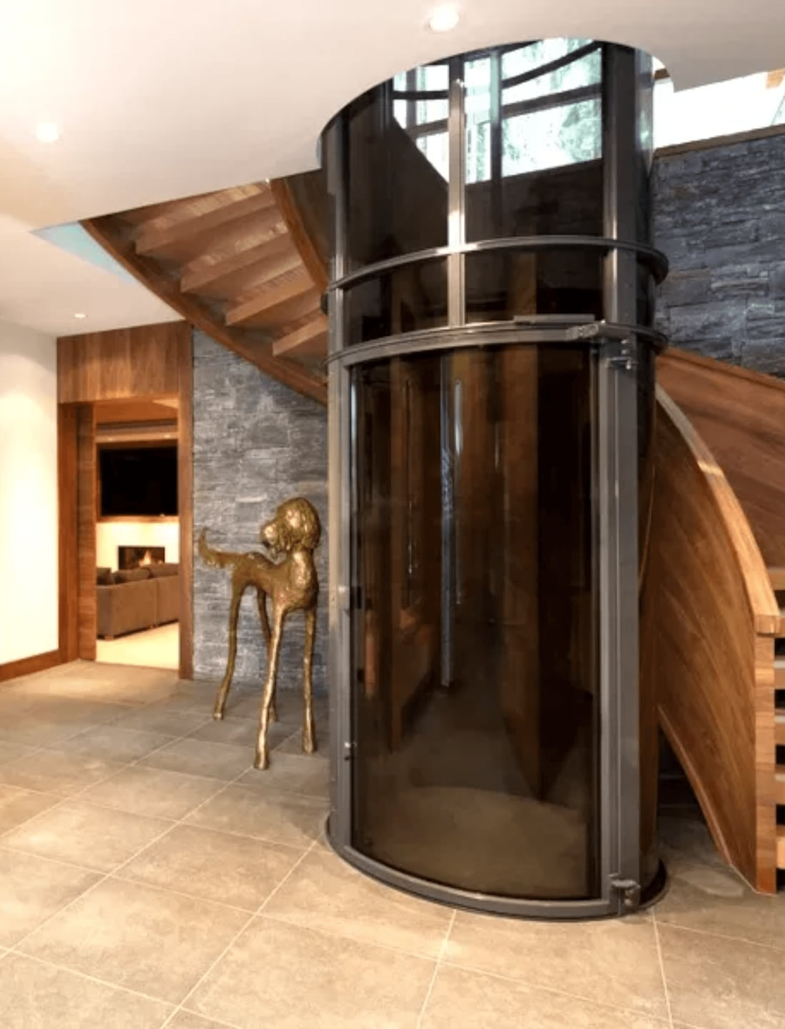
PVE 52: Uncompromising Accessibility and Capacity
Capacity
3 Passengers or 1 Wheelchair + Attendant (525 lbs / 238 kg)
External Diameter
52 11/16 inches (1338 mm)
Door Opening
32 inches (813 mm) - ADA Compliant
Safety Standards
ASME A17.7 Certified for Public & Private Use
Primary Applications
Hospitals & Clinics
Public Institutions
Inclusive Residences
Flagship Model
Boutique Hotels
Inclusive Mobility Solutions
"The PVE 52 is critical for meeting modern 'Disabled Friendly' building codes in West Africa, providing seamless vertical transportation for all users without structural compromise."

Slide 9

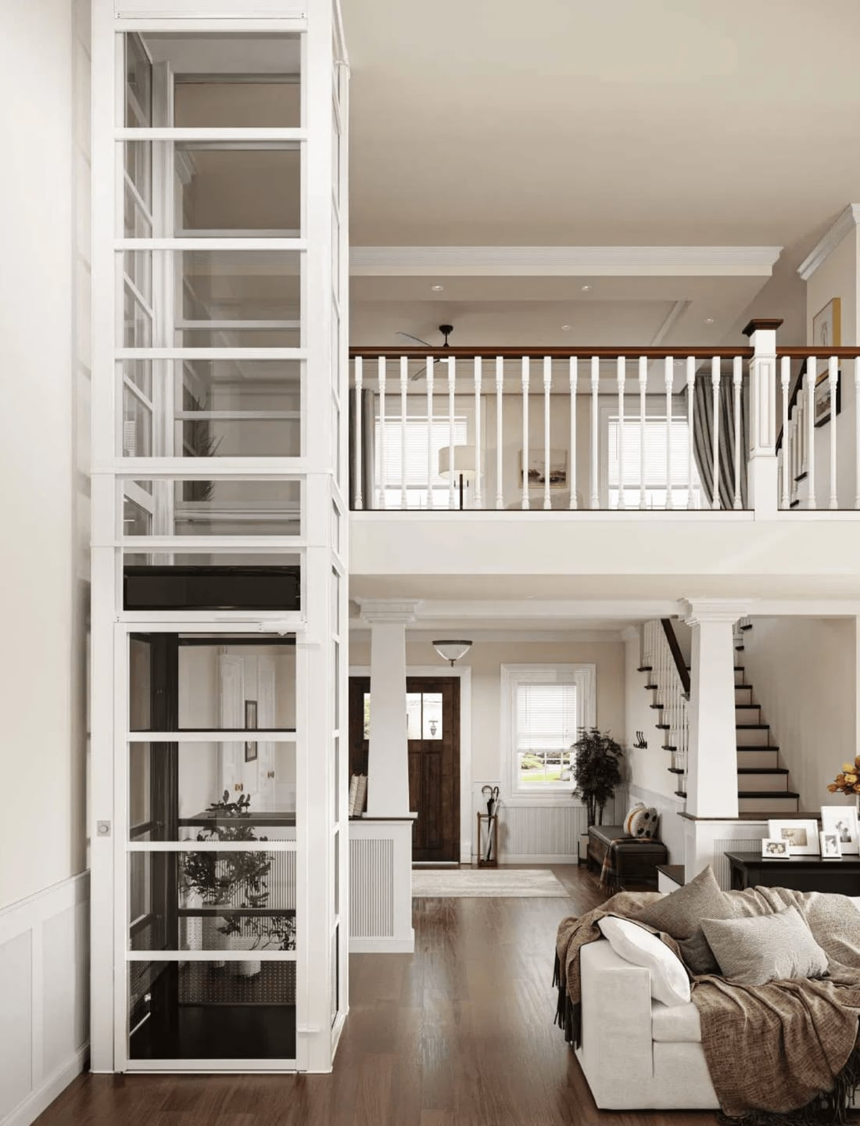
PE Cube: Square Profile for Contemporary Architecture
Capacity
2 Passengers (450 lbs / 205 kg)
Dimensions
36" x 36" External Footprint
Travel
Up to 35 ft (3 Stops)
Key Feature
Seamless Integration into Corners & Square Stairwells
Primary Applications
Corner Installations
Square Stairwells
Modern Residences
Geometric Innovation
Linear Architectures
Modern Square Profile
"The PE Cube is targeted at architects who prefer clean, linear design aesthetics, offering a modern alternative to the traditional circular pneumatic profile."

Slide 10





World-Class Engineering with Fail-Safe Safety Systems
Pneumatic Power
Power Outage Safety
Air-Driven Efficiency
Fail-Safe Gravity Descent
Our elevators use advanced air pressure technology to lift the cabin. This eliminates the need for cables, pulleys, or pistons, resulting in a smoother, quieter, and more energy-efficient ride.
In the event of a power failure, the elevator automatically descends to the ground floor using gravity. No batteries or backup power are required for this critical safety function.
Smart Technology
Global Compliance
IoT & Predictive Maintenance
Certified Excellence
Integrated smart sensors monitor system health in real-time, allowing for predictive maintenance and remote diagnostics to ensure maximum uptime and performance.
PE Lifts meet and exceed the most rigorous international standards, ensuring peace of mind for residential, commercial, and public installations across West Africa.
ISO 9001 (TÜV SÜD)
CE CERTIFIED
ASME A17.7
ECOWAS COMPLIANT

Slide 11

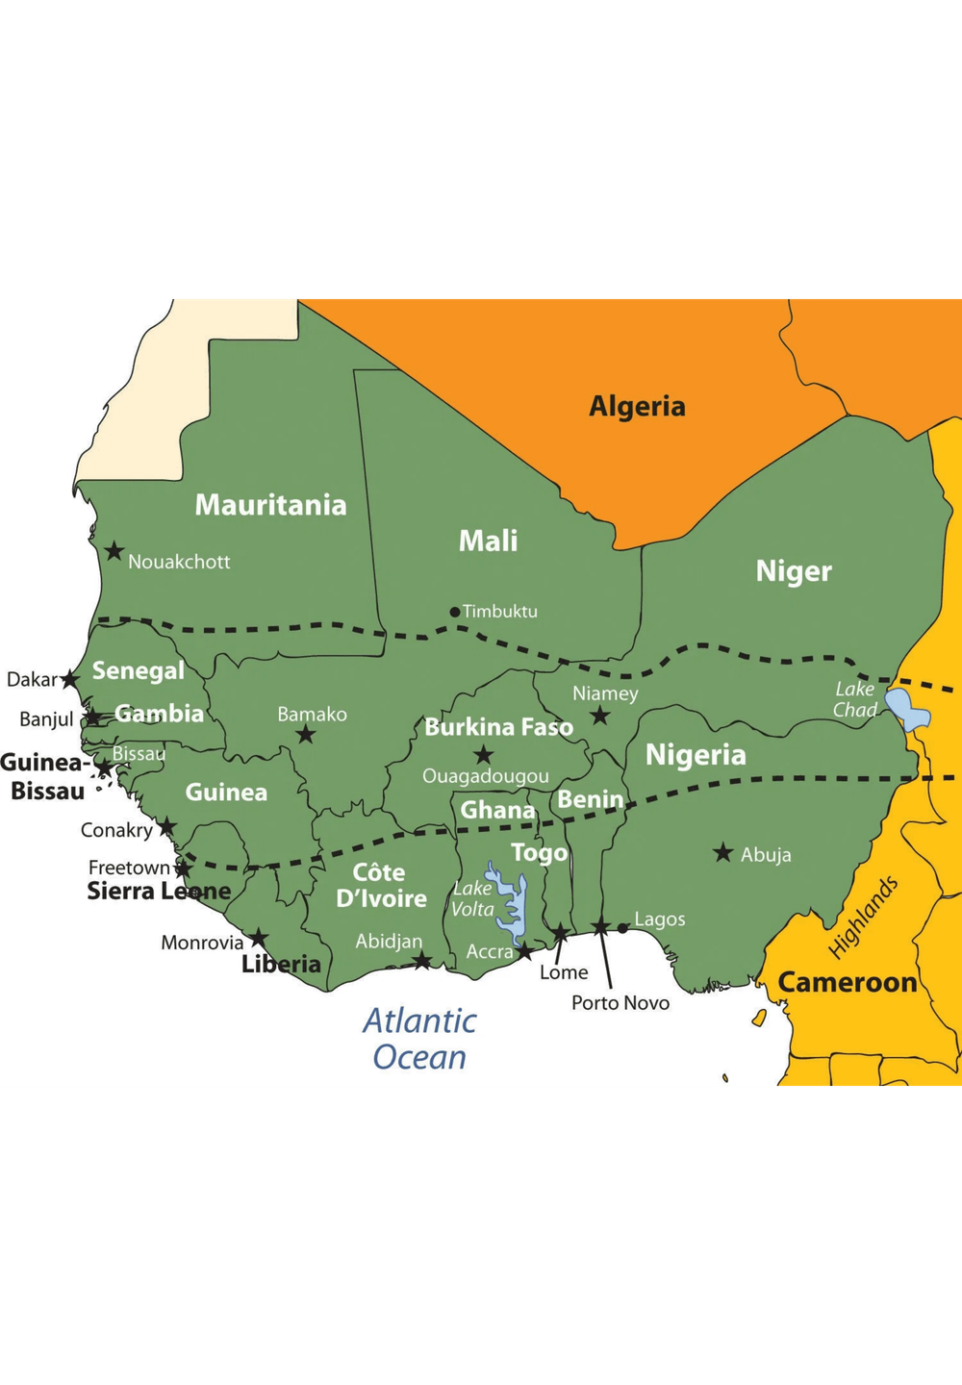

Unmatched Support Across the West African Sub-Region
Warranty
Response
24-Month Coverage
4-Hour Guarantee
Comprehensive parts & labor warranty ensuring long-term peace of mind.
24/7 emergency model with guaranteed on-site arrival in major cities.
Maintenance
Expertise
Preventive Care
Certified Teams
Tailored service packages for tropical environments to maximise longevity.
100+ factory-certified technicians for local sales, installation & support.
Nigeria
Ghana
Senegal
Côte d'Ivoire
Lagos | Abuja | PH
Accra | Kumasi
Dakar
Abidjan

Slide 12

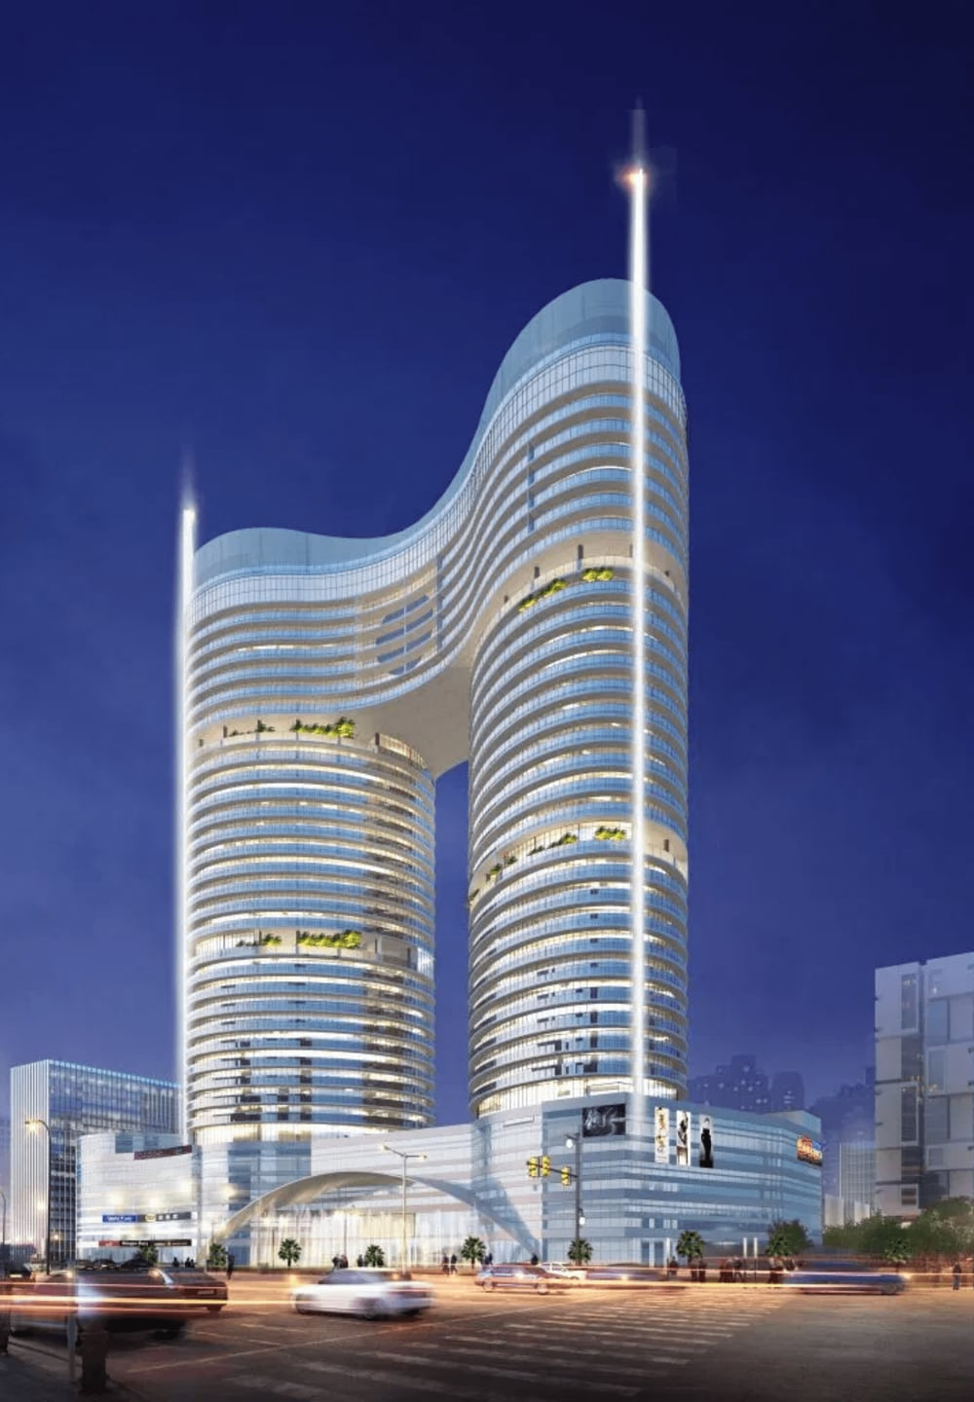


PE Lifts | Case Studies
Elevating the
Standard of Living
in West Africa
Residential
Commercial
Healthcare
Luxury penthouse installations in Eko Atlantic, Lagos, providing seamless vertical mobility.
Boutique hotel projects in Accra, Ghana, enhancing guest experience with panoramic views.
Specialized clinic accessibility in Dakar, Senegal, meeting strict medical safety standards.
www.pelifts.com
Regional Hubs
info@pelifts.com
Lagos Accra Dakar Abidjan
Schedule a Consultation Today

